Slide 2


FUTURE TENSES: WILL/BE GOING TO
I will travel to Japan next summer : decision
I am going to study German at school: plan

Slide 3
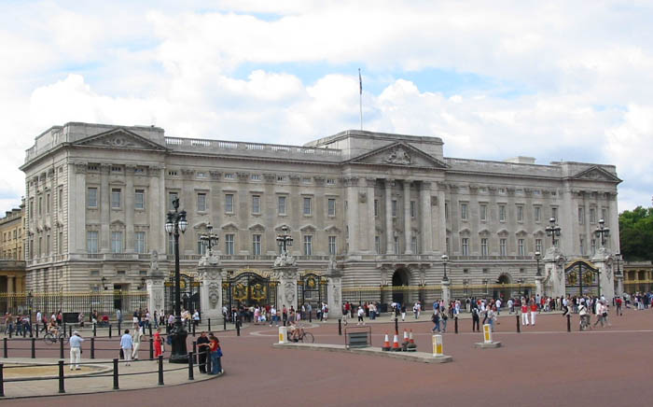
WILL / GOING TO
The simple Future has two different forms in English: will and be going to. Although the two forms can sometimes be used interchangeably, they often express two different meanings as mentioned before.
I will probably go to London next summer.
I am going to fly to London next Saturday.

Slide 4
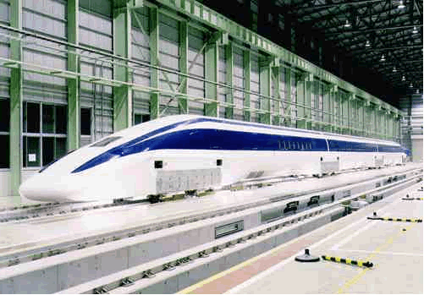
FUTURE TENSE : WILL FORM
Affirmative: I will travel to Madrid in October
Interrogative: Will you travel by bus?
Negative: I will not travel – won´t
Will you travel by train or by bus?
I won’t travel by bus I will probably travel by train

Slide 5
FUTURE TENSES: USES OF WILL
1.-Instant decisions: Ok, I’ll see you on Friday
2.-Predictions based in what we think: It will rain in the evening.
3.- Promises and offers: Don’t worry, I’ll go and buy some food for you.

Slide 6

FUTURE TENSE: BE GOING TO - FORM
Affirmative: I am going to travel by plane.
Interrogative: Are you going to travel by plane?
Negative: I am not going to travel
by plane because I am going to fly
in a hot air balloon.

Slide 7

FUTURE TENSE: USES OF GOING TO
1.- Future plans and intentions: I am going
to buy a new laptop computer next week
2.- Predictions based in what we can see at the moment; Look at that car! It is going to crash into the lamp post.

Slide 8

FUTURE TENSES
TIME EXPRESIONS
Tomorrow, next week, next month, next year…
I am going to travel to New York next year

